Slide 1


Slide 2
“Does your code work?”
“Yes it does!”
“Have you run it?”
“No”
!?!?

Slide 3
Testing

Slide 4
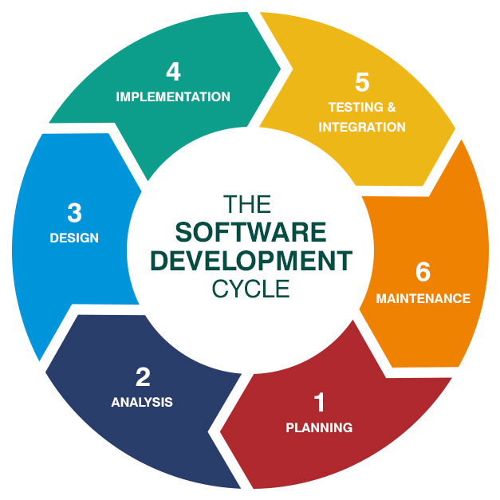
This Lecture
Aims
types of Testing
NUnit testing framework

Slide 5
Aim of Testing
The goal of testing is to discover defects (bugs) in programs

Slide 6
Aim of Testing
The goal of testing is to discover defects (bugs) in programs
Defect
Problem
Error
Incidence
Anomaly
Inconsistency
…….Feature ?

Slide 7
Where do bugs come from ?
Wrong Requirements
Design
Implementation
Development Tools
Incorrect Testing

Slide 8
Costs of SW bugs
Cost to fix a bug increases exponentially at each stage
- specification 1 £
- design 10£
- coding 100£
- released software 1000£

Slide 9
Costs of SW bugs
Software bugs can be expensive and dangerous
To err is human but to
really foul things up you need a computer
Paul Elrich

Slide 10

Case Study: Millennium Bug (Y2K)
Emerged due to original need to save on memory.
Extensive campaigns to resolve the issue during the 90s.
Estimated* to have cost between $300 & $500 Billion to resolve worldwide…
Yr = 95
I
V
Yr = 1995
*Based on estimates by UN International Y2K Committee

Slide 11


Case Study: NASA - Mariner 1 (1962)
Intended to perform flyby of Venus.
Veered dangerously off course during launch.
Caused by miscalculation due to misplaced ‘_’ in FORTRAN code.
Estimated to cost $147 Million*
*$18.5 Million in 1962, adjusted for inflation
Notes:
Intended for venus flyby, had to be self-destructed due to bug causing it to veer dangerously off course. Estimated to have cost $18.5 million or $147 million today.

Slide 12
SW bugs
In 1979, 5 nuclear plants in US has to be switch off because of a bug in the software used to help in case of earthquakes
(using natural instead of the absolute values of numbers)

Slide 13
SW bugs
In 1979, 5 nuclear plants in US has to be switch off because of a bug in the software used to help in case of earthquakes
(using natural instead of the absolute values of numbers)
15 January 1990, 5 million calls were blocked in US for 9 hours
(wrong break statement in C code)

Slide 14
SW bugs
In 1979, 5 nuclear plants in US has to be switch off because of a bug in the software used to help in case of earthquakes
(using natural instead of the absolute values of numbers)
15 January 1990, 5 million calls were blocked in US for 9 hours
(wrong break statement in C code)
A wrong IF.ELSE condition caused a UK bank to duplicate worldwide transfer payments for 30 minutes (lost 2 billion British pounds in early ‘90s)

Slide 15
SW bugs
Mars Climate Orbiter destroyed (’90s)
Software on ground generating commands in pound-force while orbiter was expecting newtons

Slide 16
SW bugs
Mars Climate Orbiter destroyed (’90s)
Software on ground generating commands in pound-force while orbiter was expecting newtons
Hitomi satellite destroyed (2016)
A thruster fired in the wrong direction and the satellite got destabilized

Slide 17
SW bugs
Therac-25 radiation therapy administered excessive quantities of radiation (variable not correctly initialized). At least 5 people died in ‘80s.

Slide 18
SW bugs
Therac-25 radiation therapy administered excessive quantities of radiation (variable not correctly initialized). At least 5 people died in ‘80s.
2^{15,} overflow of 16-bit words
A Washington D.C. hospital computer system collapsed on 19 September 1989, 2¹⁵ = 32,7968 days after January 1, 1900

Slide 19
SW bugs
Therac-25 radiation therapy administered excessive quantities of radiation (variable not correctly initialized). At least 5 people died in ‘80s.
2^{15,} overflow of 16-bit words
A Washington D.C. hospital computer system collapsed on 19 September 1989, 2¹⁵ = 32,7968 days after January 1, 1900
Vancouver Stock Exchange; repeated rounding error (loss of 25 points per month). Had to be restarted in ‘82.

Slide 20
Only exhaustive testing can show a program is free from defects.
However, exhaustive testing is impossible

Slide 21
Only exhaustive testing can show a program is free from defects.
However, exhaustive testing is impossible
GUI with 6 input fields, each 10 possible values
Number combinations to test = 10^6 = 1000000

Slide 22
Testing can only show the presence of bugs
(not the absence) and can reduce the risks
of undiscovered bugs
Never claim a SW is bug-free

Slide 23
Functional vs Non-Functional Testing
Functional Testing
Verify a specific action of the code (eg, print, display, checks,..)
Does it feature work ?
Non-functional Testing
Aspects not related to a specific function (eg, scalability, usability,..)
How does the code scale ? Stress test.

Slide 24
Static vs Dynamic Testing
Static
Inspection of the code (useful to check scalability and efficiency, Big O notation, maintainability index)
Dynamic
Running the code

Slide 25
Testing Methods
Black Box approach, no access to the code
White box approach, access to the code

Slide 26
Testing Methods: Black Box
Black Box approach, no access to the code
Treats the software as a black box (as a “user”).
inputs
software
output
is the one
expected ?

Slide 27
Testing Methods: Black Box
Black Box approach, no access to the code
Advantages
Tester has no “bonds” with the code, will find a bug
(unaffiliated opinion)
Disadvantages:
Without knowledge of the code, many inputs could be redundant (blind exploring)

Slide 28
Testing Methods: Black Box
Cannot test all possible inputs
Equivalence Partitioning : Divide inputs into partitions and select 1 representative input for each partition
Boundary Value Analysis: Determine boundaries of the input and check cases at the boundaries and just inside/outside the boundaries

Slide 29
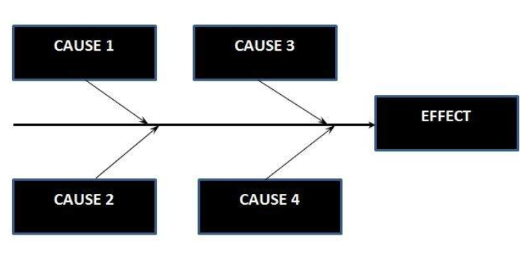
Testing Methods: Black Box
Cause-effect Graphs
Using a graph to capture the relationship input-output
and avoid combinatorial explosion

Slide 30
Testing Methods: White Box
White Box approach, access to the code
Code coverage – creating tests to satisfy code coverage (e.g., all statements in the program should be executed at least once).
Cyclomatic complexity (Visual Studio metrics).
Can be used together with testing framework (eg NUnit)

Slide 31
Black Box vs White Box Testing
Black box
White box
not required
knowledge of
structure and code
required
testers
responsibility
developer
not necessary
programing knowledge
essential
specifications
test cases derived from..
code

Slide 32
Testing Methods: Grey Box
Grey Box approach, access to the code but still testing as a “user”

Slide 33
Define the Test Cases
Typical test cases
The normal case
The extremes
Nulls and illegal input
Strange input
From G. McDowell, Cracking the Coding Interview

Slide 34
Define the Test Cases
Typical test cases
-The normal case
Does it generate the correct output for typical inputs ?
Example – if your algorithm uses some kind of arrays, does it work for odd, even number of elements ?

Slide 35
Define the Test Cases
Typical test cases
- The extremes
Does it generate the correct output for non-typical inputs ?
Example – if your algorithm uses some kind of array, what happens if you input an empty array ? Or a very small (one element) array ? Or a very large one ?

Slide 36
Define the Test Cases
Typical test cases
-Nulls and illegal inputs
How your code behave when given illegal input ?
Example – if your algorithm requests a number n of requests, what happens if n is negative ?

Slide 37
Define the Test Cases
Typical test cases
- Strange inputs
How your code behave when given strange input ?
Example – if your algorithm sort an array given as input, what happens if you pass an already sorted array ? Or an array sorted in reverse order ? Or array with all identical elements ?

Slide 38
Testing Levels
ACCEPTANCE TESTING
SYSTEM TESTING
INTEGRATION TESTING
UNIT TESTING

Slide 39
Testing Levels
Unit testing (Component testing)
Tests that verify the functionality of a specific section of code (eg class and methods level).

Slide 40
Testing Levels
Integration testing
Tests that the integration of the different components work correctly.
Always integrate components in an incremental way.
Done by an independent team.

Slide 41
Testing Levels
System testing
Tests that the full integrated system works correctly (respects the requirements)

Slide 42
Testing Levels
Acceptance testing
Tests that the full integrated system works correctly and is ready to be distributed to the final users
Alpha and Beta testing

Slide 43
Testing Levels
Alpha testing
Testing by potential users at the developers’ site
Beta testing
Testing by a limited audience outside the programming team (sometimes beta versions are made public)

Slide 44
Testing models
Waterfall
Traditional: Testing is done by an independent group of testers after the functionality is developed

Slide 45
Testing models
Agile / Extreme
Test-driven development.
Tests are developed first and then the code is written (incrementally) until passes all tests.

Slide 46
Tools for Unit (Component) Testing
xUnit family of tools (open source software).
Kent Beck developed SUnit in 1999.
Erich Gamma ported SUnit to Java, creating JUnit.
JUnit gave CppUnit, NUnit, PyUnit, XMLUnit, and ports to other languages.
NUnit
Unit test framework for the Microsoft .NET architecture.
follows the xUnit model, serving as a foundation for building unit test classes and methods.
implemented in C#, but supports writing unit tests in any .NET language.

Slide 47
NUnit
NUnit: relies on C# attributes to structure test code.
An attribute is metadata attached to a code element such as a class or method.
See Tutorial on Moodle

Slide 48
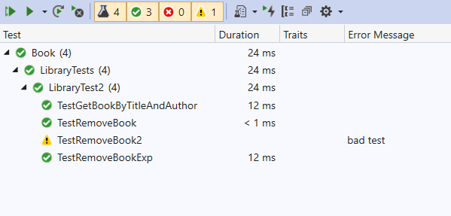
Run NUnit in Visual Studio
Test > Test Explorer > Run All Tests

Slide 49
NUnit Attributes
TestFixture
Marks a class that contains tests
Test
Marks a method (testcase) in a test class
SetUp
Marks a method which is executed just before each
test method
OneTimeSetUp
Marks a method that is executed once before any
test

Slide 50
NUnit Attributes
OneTimeTearDown
Marks a method that is executed once after all tests have been
executed
TearDown
Marks a method executed after each test
Ignore
Marks a test case which (temporarily) should not be executed
Full list of NUnit attributes:
https://docs.nunit.org/articles/nunit/writing-tests/attributes.html

Slide 51
Example : Using NUnit
using System;
namespace Library
{
public class Book
{
private string title;
private string author;
public string Title
{ get{ return title; }
set{ title = value; }
}
public string Author
{
get{ return author; }
set{ author = value;}
}
public Book(string title, string author)
{
this.title = title;
this.author = author;
}
}
}
Develop Application and Tests at same time
Book
title
author

Slide 52
Example : Using NUnit
public class Library
{
private Hashtable books;
public Library()
{
books = new Hashtable();
}
public void addBook(Book book)
{
books.Add(book.Title, book);
}
public Book getBook(string title, string author)
{
return (Book)books[title];
}
public void removeBook(string title)
{
if (books[title] == null)
throw new Exception("book not found");
books.Remove(title);
}
}
Develop tests for the Library Class

Slide 53
Example : Using NUnit
using System;
using System.Collections.Generic;
using System.Linq;
using System.Text;
using System.Threading.Tasks;
namespace librarytest
{
using library; // this allows to use Library and Book class
using NUnit.Framework;
[TestFixture] // denotes the class that contains tests
class LibraryTest
{
}
}
namespace
different from
the application
create a test class

Slide 54
Example : Using NUnit
private Library library;
private Book book1, book2;
[OneTimeSetUp]
//executed once before any test
public void TestFixtureSetUp()
{
book1 = new Book("Java Sucks", "Microsoft");
book2 = new Book("C# Rules", "Microsoft");
}
[OneTimeTearDown]
//executed once after all tests
public void TestFixtureTearDown() { }
[SetUp] //executed just before each test
public void SetUp()
{
library = new Library();
library.addBook(book1);
library.addBook(book2);
}
[TearDown] // executed just after each test
public void TearDown() { }
add tests in the test class

Slide 55
Example : Using NUnit
[Test] // denotes a test case; this test case checks that the getBook method works as expected:
// recovers the correct Title and Author of a Book
public void TestGetBookByTitleAndAuthor()
{
Book book = library.getBook("Java Sucks", "Microsoft");
Assert.AreEqual("Java Sucks", book.Title, "wrong title");
Assert.AreEqual("Microsoft", book.Author, "wrong author");
}
[Test] //denotes a test case
public void TestRemoveBook()
{
library.removeBook("Java Sucks");
Book book = library.getBook("Java Sucks", "Microsoft");
}
[Test, Ignore("bad test")] // this test case that will be ignored
public void TestRemoveBook2()
{
library.removeBook("Java Sucks");
Book book = library.getBook("Java Sucks", "Microsoft");
}

Slide 56
Example : Using NUnit
[Test] // denotes a test case. This checks if an exception is thrown when removebook is called
//on a book that is not in the library
public void TestRemoveBookExp()
{
Assert.Throws<Exception>(() =>
{
library.removeBook("Not There");
});
}

Slide 57
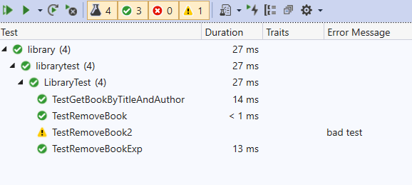
Example : Using NUnit
Test -> Test Explorer -> Run All Tests

Slide 58
Example : Using NUnit
public class Library
{
private Hashtable books;
public Library()
{
books = new Hashtable();
}
public void addBook(Book book)
{
books.Add(book.Title, book);
}
public Book getBook(string title, string author)
{
return (Book)books[title];
}
public void removeBook(string title)
{
// if (books[title] == null)
// throw new Exception("book not found");
// books.Remove(title);
}
}
Comment out

Slide 59
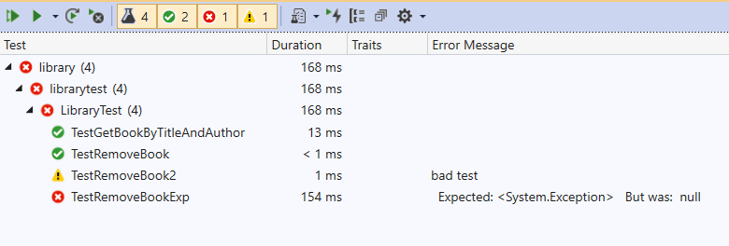
Example : Using NUnit
public class Library
{
private Hashtable books;
public Library()
{
books = new Hashtable();
}
public void addBook(Book book)
{
books.Add(book.Title, book);
}
public Book getBook(string title, string author)
{
return (Book)books[title];
}
public void removeBook(string title)
{
// if (books[title] == null)
// throw new Exception("book not found");
// books.Remove(title);
}
}

Slide 60
Nunit Assertions
[Test] // test case
public void TestGetBookByTitleAndAuthor()
{
Book book = library.getBook("Java Sucks", "Microsoft");
Assert.AreEqual("Java Sucks", book.Title, "wrong title");
Assert.AreEqual("Microsoft", book.Author, "wrong author");
}
[Test] // test case
public void TestRemoveBook()
{
library.removeBook("Java Sucks");
Book book = library.getBook("Java Sucks", "Microsoft");
}
}
}
Assert:
Is the output obtained the one expected ?
Notes:
“Microsoft” denotes the expected value; book. Author denotes the actual value obtained; “wrong author” denotes the message to be displayed if the test fails

Slide 61
Nunit Assertions
NUnit provides a variety of test assert methods.
IsTrue(bool condition)
IsFalse(bool condition)
AreEqual(decimal expected, decimal actual)
AreEqual(int expected, int actual)
AreEqual(double expected, double actual, double delta)
AreEqual(float expected, float actual, float delta)
AreEqual(Object expected, Object actual)
AreSame(Object expected, Object actual)
IsNotNull(Object anObject)
IsNull(Object anObject)
Fail()
https://docs.nunit.org/articles/nunit/writing-tests/assertions/assertions.html

Slide 62
Recap
Testing
Unit Testing
Unit Testing Tools
On Moodle: Tutorial on NUnit

